Slide 1
Lecture XIV
Garbage and Solid Waste Pollution

Slide 2
GARBAGE
Can be easily touched, seen and smell.
Growing accumulation depresses land values, increases traffic, and ruins health, aesthetics and the necessities of life.
432, 000 tons from people of limited state per day
“NIMBY” mindset
Four categories
Biodegradables/non-biodegradables
Combustibles/non-combustibles
Recyclables/non-recyclables
Hazardous waste

Slide 3
Causes of Garbage
Effects of “throw-away and disposable society”.
Overpopulation of people on Earth.
Overproduction of packaging materials, bottles, diapers and other non-degradable materials.
Overproduction of newspaper, plastic bags and containers.
Land clipping
Medical waste or infectious waste (“red bag”)
Burning tires
Household wastes

Slide 4
Effects of Garbage
A torrent of garbage thrown away every year
Accumulated garbage pile
Some decomposing waste produces methane
No available dumpsites
The use of incinerator may produce more pollution.
Recycling technology

Slide 5
Solid Waste Pollution
Three different types of solid waste
Municipal waste
Industrial waste
Toxic and hazardous waste

Slide 6
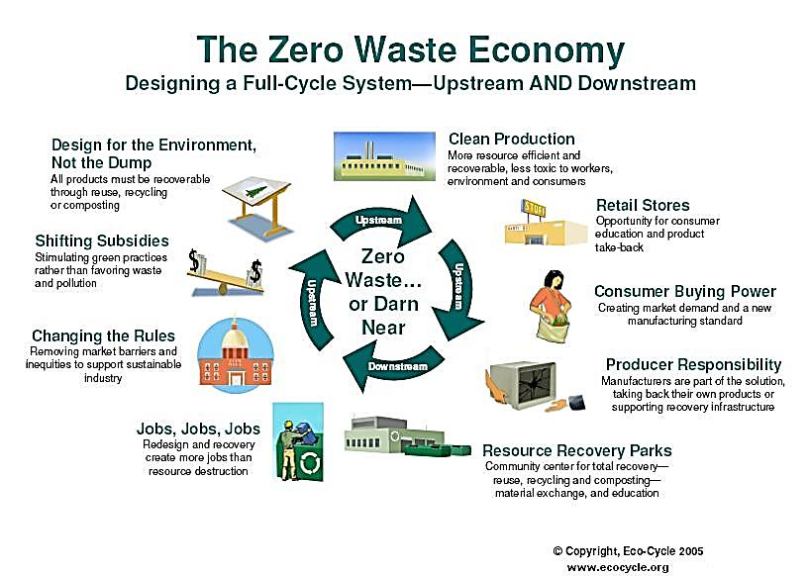
Solid Waste Management Methods
Zero Waste Management – Reduce, Reuse and Recycle (3R)

Slide 7
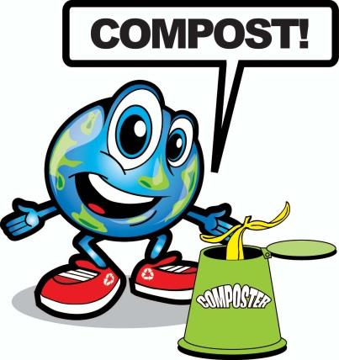
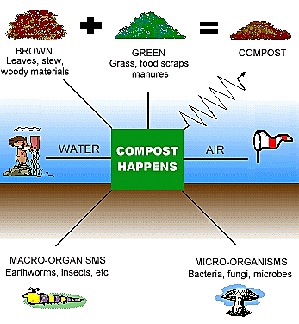
Solid Waste Management Methods
Composting

Slide 8
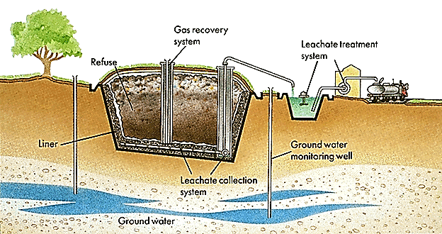
Solid Waste Management Methods
Sanitary Landfill

Slide 9
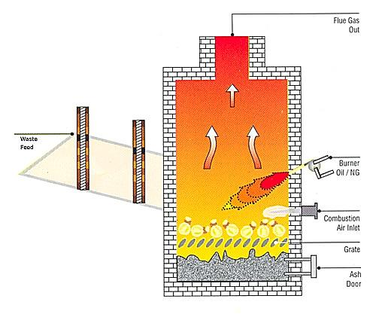
Solid Waste Management Methods
Incinerators

Slide 10
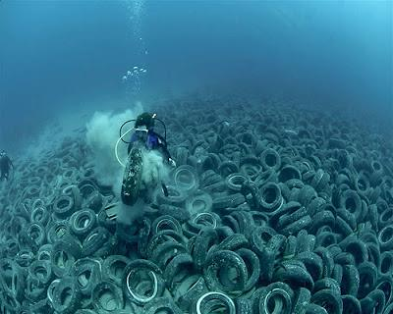
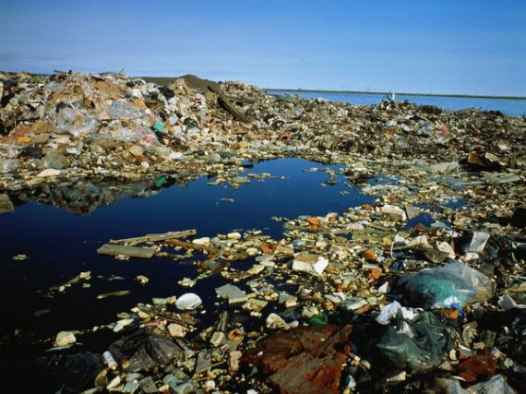
Solid Waste Management Methods
Ocean Dumping

Slide 11
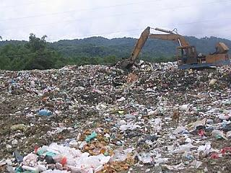
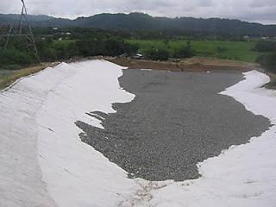
Solid Waste Management Methods
Open Dumpsite

Slide 12
Solid Waste Management Methods
Garbology

Slide 13
MANAGING OUR SOLID WASTE: AN OVERVIEW OF THE ECOLOGICAL SOLID WASTE MANAGEMENT ACT

Slide 14
Why we?

Slide 15
Why now?
What is R.A. No. 9003?
What are the salient features of R.A. No. 9003?
a. Creation of the NSWMC, NEC and the Solid Waste Management Board
b. Formulation of the National Solid Waste Management Framework
c. Mandatory segregation of Solid Waste
d. Setting of minimum requirements
e. Establishment of reclamation programs and buy-back centers
f. Promotion of eco-labeling

Slide 16
g. Prohibition on non-environmentally acceptable products and packaging
h. Establishment of Materials Recovery Facility
i. Prohibition against the use of open dumps
j. Setting of guidelines/criteria
k. Provision of rewards
l. Promotion of research and environmental education

Slide 17
3. How can we help solve the solid waste problem?

Slide 18
Philippine efforts in controlling Solid waste
Accelerated Composting Technology (Bioreactor)
Anaerobic Composting (Biogas Reactor)
Vermicomposting

Slide 19
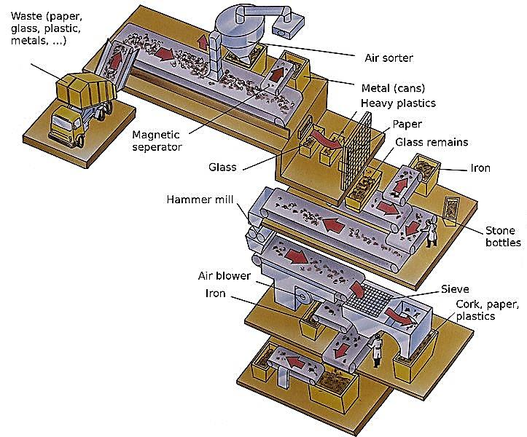
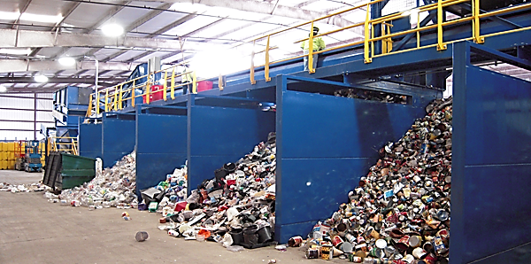
A case in point: Material Recovery Facility
(San Pablo, Laguna)

Slide 20
Thank you for listening!
Reported by:
Perez, May Ann T.
Macapagal, Aprilyn M.

